Slide 1
Black Box and White Box Testing

Slide 2

In the field of software testing, some methods are used to find defects and evaluate the quality of the product. Among them are White-Box Testing and Black-Box Testing. Let's see what each of them is about.

Slide 3
Black Box Testing:
In this method, the tester selects a function and gives input value to examine its functionality, and checks whether the function is giving the expected output or not. If the function produces the correct output, then it is passed in testing, otherwise failed.
The main objective of implementing black box testing is to specify the business needs or the customer’s requirements.
.

Slide 4
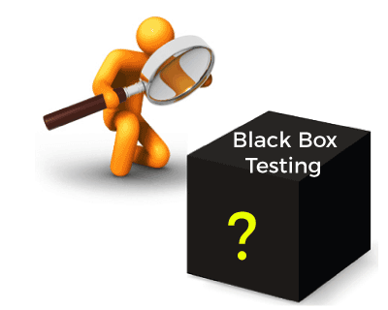
Mainly, there are three types of black-box testing: functional testing, Non-Functional testing, and Regression testing. Its main objective is to specify the business needs or the customer’s requirements.

Slide 5
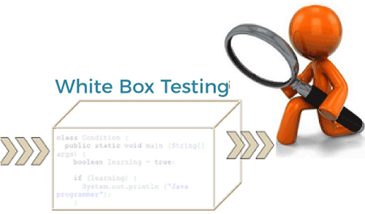
White Box Testing:
The term 'white box' is used because of the internal perspective of the system. The clear box or white box, or transparent box name denotes the ability to see through the software's outer shell into its inner workings.

Slide 6
It is performed by Developers, and then the software will be sent to the testing team, where they perform black-box testing. The main objective of white-box testing is to test the application's infrastructure. It is done at lower levels, as it includes unit testing and integration testing.
It is also known as structural testing, clear box testing, code-based testing, and transparent testing. It is well suitable and recommended for algorithm testing.

Slide 7
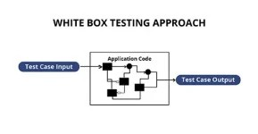
White Box Testing

Slide 8
Black Box Vs White Box Testing
Black Box Testing | White Box Testing
The Black Box Test is a test that only considers the external behavior of the system; the internal workings of the software is not taken into account. | The White Box Test is a method used to test a software taking into consideration its internal functioning.
It is carried out by testers. | It is carried out by software developers.
This method is used in System Testing or Acceptance Testing. | This method is used in Unit Testing or Integration Testing.
It is the least time consuming. | It is most time consuming.
It is the behavior testing of the software. | It is the logic testing of the software.
It is also known as data-driven testing, functional testing, and closed box testing. | It is also known as clear box testing, code-based testing, structural testing, and transparent testing.
Black Box Test is not considered for algorithm testing. | White Box Test is well suitable for algorithm testing.

